Slide 1
Advanced Software Engineering Course
Behavioral Design Patterns
Antonio Di Monaco
Computer Science Bachelor Program

Slide 2
Topics
Behavioral
  Introduction
  Chain Of Responsibility
  Command
  Interpreter
  Iterator
  Mediator
  Memento
  Observer
...
  State
  Strategy
  Template Method
  Visitor
Reference: https://refactoring.guru/design-patterns

Slide 3
Introduction
Behavioral patterns defines algorithms and responsibilities between objects, and the communication between them.
  Request to a chain of candidate objects capable to handle such request (Chain Of Responsibility)
  Create a dependency publish/listen between objects (Observer)
  Loose coupling among objects (Mediator)
  Encapsulate state in objects (State)
  Encapsulate an algorithm in an object (Strategy)
  Encapsulate request in objects (Command)
  Abstraction of an algorithm (Template Method)
  Capture and externalize an object's internal state so it can be restored later (Memento)
  Class hierarchy of operations on classes (Interpreter)
  Encapsulate behavior in objects (Visitor)
  Abstract objects access in an aggregate (Iterator)
Object
Communication
Algorithmic
Data Access /
Traversal

Slide 4
Chain Of Responsibility - Problem
Imagine a support desk: a customer opens a ticket, but nobody knows in advance which employee will solve it. A naive implementation couples the sender of a request to a single, specific receiver:
if (ticket.isHardware()) hardwareAgent.solve(ticket);
else if (ticket.isBilling()) billingAgent.solve(ticket);
else if (ticket.isLegal()) legalAgent.solve(ticket);
else ... // and every new kind of ticket forces a change here
This design has three defects:
Tight coupling — the client must know, at compile time, exactly which object will handle each request.
Violation of Open/Closed — adding a new kind of handler (or a new ticket type) requires modifying the client's dispatch logic.
No flexibility at runtime — the routing rules are hard-coded; they cannot be reconfigured, reordered, or extended without redeployment.

Slide 5
Chain Of Responsibility - Usage
When to use it
The sender shouldn't know which receiver handles the request - decouples producer from consumer
Multiple objects are potentially able to handle a request, and you don't want to hard-code if A then B else C logic in one place
The set of handlers, or their order, must change at runtime
When not to use it
The routing is simple and static
You must guarantee the request is handled, and can't tolerate silent loss
Only ever one handler will exist / handle

Slide 6
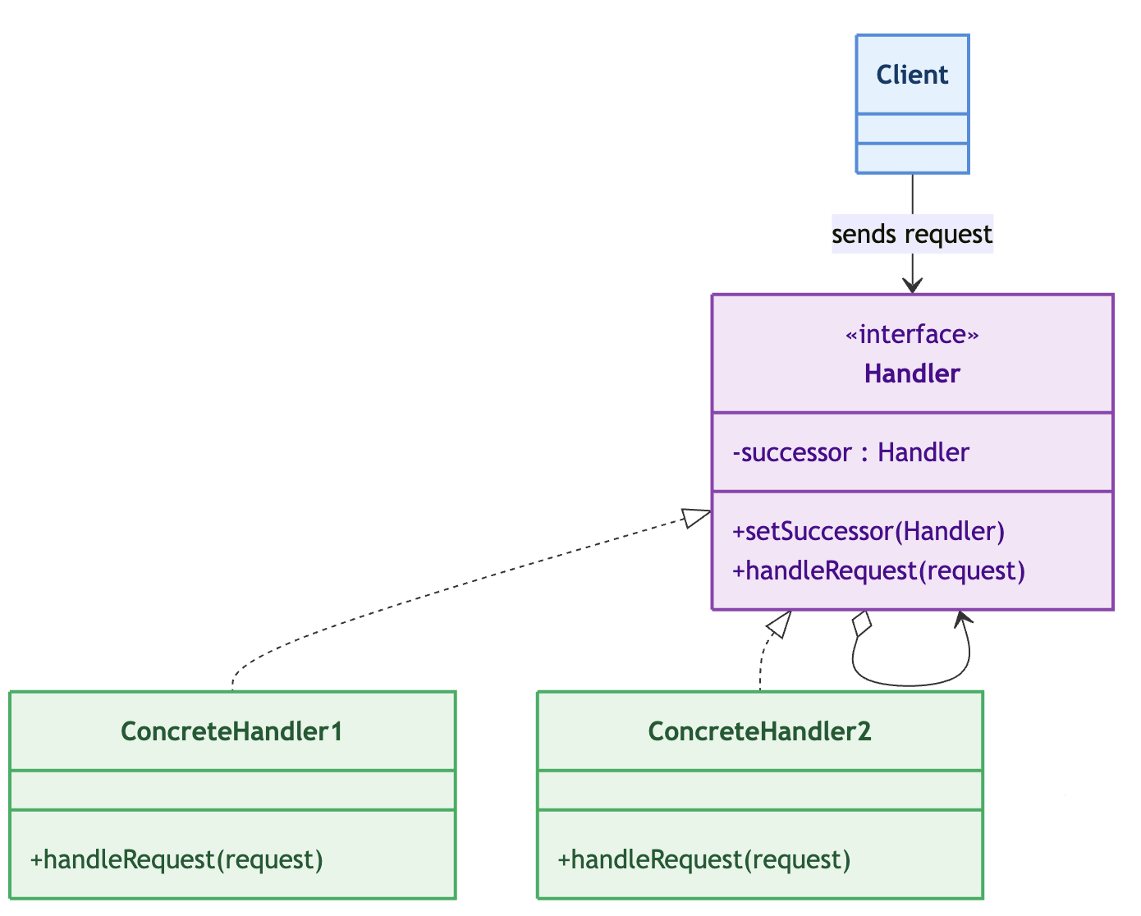
Chain Of Responsibility – Class Diagram

Slide 7
Chain Of Responsibility – Main concept
public interface Handler {
Handler setNext(Handler handler);
Object handle(Request request);
}
public abstract class AbstractHandler implements Handler {
private Handler nextHandler;
@Override
public Handler setNext(Handler handler) {
this.nextHandler = handler;
return handler;
}
@Override
public Object handle(Request request) {
if (nextHandler != null) {
return nextHandler.handle(request);
}
return null;
}
}

Slide 8
Chain Of Responsibility – Ticketing System – Base classes
public class Ticket {
public enum Severity { BASIC, INTERMEDIATE, ADVANCED }
private final int id;
private final String description;
private final Severity severity;
// constructor + getters ...
}
public abstract class SupportHandler {
private SupportHandler nextHandler;
protected final String levelName;
public SupportHandler setNext(SupportHandler handler) {
this.nextHandler = handler;
return handler;
}
public final void handle(Ticket ticket) {
if (canHandle(ticket)) {
process(ticket);
} else if (nextHandler != null) {
System.out.printf("[%s] Cannot handle %s. Escalating...%n",
levelName, ticket.getSeverity());
nextHandler.handle(ticket);
} else {
System.out.printf(
"[%s] End of chain! Ticket unresolved.%n",
levelName);
}
}
protected abstract boolean canHandle(Ticket ticket);
protected abstract void process (Ticket ticket);
}

Slide 9
Chain Of Responsibility – Ticketing System - Consumers
public class Level1Support extends SupportHandler {
public Level1Support() { super("Level-1 Support"); }
@Override
protected boolean canHandle(Ticket t) {
return t.getSeverity() == Ticket.Severity.BASIC;
}
@Override
protected void process(Ticket t) {
System.out.printf("[%s] RESOLVED → %s%n", levelName, t);
}
}
// Level2Support → INTERMEDIATE
// Level3Support → ADVANCED
SupportHandler level1 = new Level1Support();
SupportHandler level2 = new Level2Support();
SupportHandler level3 = new Level3Support();
level1.setNext(level2).setNext(level3); // fluent chain
level1.handle(new Ticket(101, "Password reset", BASIC));
level1.handle(new Ticket(102, "App crashes on login", INTERMEDIATE));
level1.handle(new Ticket(103, "Database cluster down", ADVANCED));

Slide 10
Chain Of Responsibility – Logger

Slide 11
Chain Of Responsibility – Pros and cons
Advantages
Decouples sender from receiver: the client knows only the chain's entry point; handlers know only their own rule and the abstract next.
Open/Closed: new handler types can be added, removed, or reordered at runtime without modifying existing classes or the client.
Single Responsibility: each concrete handler encapsulates exactly one handling rule.
Dynamic routing: chains can be configured per deployment, per tenant, or per request.
Disadvantages
Unpredictable propagation: a request may travel through many handlers before being handled (or never), which makes debugging and performance analysis harder than with direct dispatch.
No guarantee of handling: unless a terminal policy exists, requests can silently fall off the end of the chain. Always define an explicit end-of-chain behavior.
Chain construction is a separate concern: someone must build and maintain the chain; a mis-ordered chain (e.g., rate limiter before auth) changes system behavior subtly.
Not for high-frequency, deep chains: recursion per link adds overhead; for very hot paths a direct dispatch table may be preferable.

Slide 12
Observer - Problem
We need a one-to-many dependency between objects so that when one object changes state, all its dependents are notified and updated automatically.
Without the pattern, a class whose state matters to many other classes must explicitly call each dependent.
This creates:
Tight coupling: the Subject knows every concrete observer type
Rigidity: adding a new dependent requires modifying the Subject (violates Open/Closed)
Duplication: the "who must be informed" logic is scattered.

Slide 13
Observer - Usage
When to use it
One-to-many dependency with unknown dependents
The set of observers changes at runtime
The what changed and the how to react are genuinely separate concerns
Broadcast semantics are desirable: one state change must inform any number of receivers, and you don't care about order
When not to use it
There is exactly one dependent
Observers must be notified in a guaranteed order and you need to know when all of them finished before proceeding
You need transactional / all-or-nothing semantics
Many-to-many interactions with complex routing rules

Slide 14
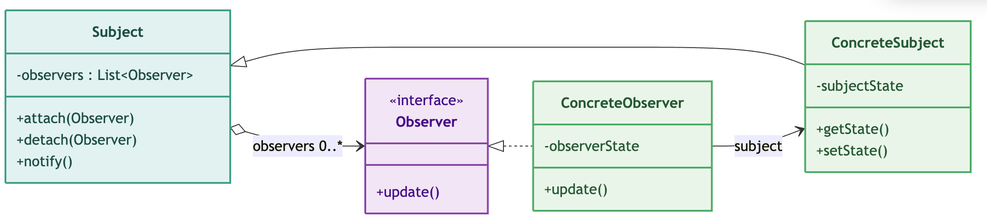
Observer – Class Diagram

Slide 15
Observer – The Pattern
public abstract class Subject {
private final List<Observer> observers = new ArrayList<>();
/** Registers an observer so it receives change notifications. */
public void attach(Observer observer) {
if (observer != null && !observers.contains(observer)) {
observers.add(observer);
}
}
/** Unregisters an observer; it will no longer receive notifications. */
public void detach(Observer observer) {
observers.remove(observer);
}
/** Notifies all registered observers.
Called by the concrete subject when its state changes. */
protected void notifyObservers() {
// Iterate over a copy so that observers can safely attach/detach
// during notification
for (Observer observer : new ArrayList<>(observers)) {
observer.update();
}
}
public int getObserverCount() {
return observers.size();
}
}
public interface Observer {
void update();
}
BEWARE OF INDIRECT
COUPLING!
Too many observers can cause
undesired effects!
(a.k.a. notification storms)

Slide 16
Observer – Weather Station
public class CurrentConditionsDisplay implements Observer {
private final WeatherData weatherData;
private float temperature;
private float humidity;
public CurrentConditionsDisplay(WeatherData weatherData) {
this.weatherData = weatherData;
weatherData.attach(this); // self-registration idiom
}
@Override
public void update() {
this.temperature = weatherData.getTemperature(); // pull the new state
this.humidity = weatherData.getHumidity();
display();
}
@Override
public void display() {
System.out.printf(" [CurrentConditions] temp=%.1f F, humidity=%.1f%%%n",
temperature, humidity);
}
}
public class WeatherData extends Subject {
private float temperature;
private float humidity;
private float pressure;
/** Simulates a new reading from the sensors. */
public void setMeasurements(
float temperature, float humidity, float pressure) {
this.temperature = temperature;
this.humidity = humidity;
this.pressure = pressure;
notifyObservers();
}
public float getTemperature() { return temperature; }
public float getHumidity() { return humidity; }
public float getPressure() { return pressure; }
}
public class WeatherMain {
public static void main(String[] args) {
System.out.println("=== Example 1: Weather Station ===");
WeatherData weatherData = new WeatherData();
CurrentConditionsDisplay current = new CurrentConditionsDisplay(weatherData);
weatherData.setMeasurements(80.0f, 75.0f, 30.2f);
// we see the current instance printing on screen
// Detach one observer: it stops receiving notifications
weatherData.detach(stats);
System.out.println("-- StatisticsDisplay detached --");
weatherData.setMeasurements(81.0f, 65.0f, 30.1f); // no print here
}
}

Slide 17
Observer – Stock market

Slide 18
Observer – Pros and cons
Advantages
Abstraction between the Subject and its observers: they do not know each other's concrete classes
New ConcreteObservers can be introduced without changing existing code.
Supports broadcast communication without the Subject specifying receivers one by one.
Disadvantages
Unknown update timing: the Subject does not know in what order or at what moment observers react; an observer may see a partially updated state
Memory leaks: if the Subject holds strong references and observers never detach, they are never garbage-collected (classic problem with inner-class listeners in Java)
Cascading updates / infinite loops: an observer that modifies its own Subject can trigger re-notification - guard against cycles
Performance: notifying many observers synchronously on the changing thread can be expensive - consider batching or asynchronous dispatch.

Slide 19
Mediator - Problem
Suppose a system has n objects that must interact (users in a chat room, traders at an exchange, fields in a form).
The naive solutions all fail:
Direct references: each object holds references to all the others
The dependency graph becomes a complete graph: n·(n−1)/2 references. Adding one participant touches every
existing one; every change ripples through the whole web.
Shared global state: (static registry, singleton) objects still couple to each other through the global
object; there is no single place where the interaction rules live, so the rules are duplicated and inconsistent.
One "manager" object that everyone calls ad hoc: the manager accumulates if (other instanceof X) spaghetti; the participants still know about each other's types, so nothing is really decoupled.
The root cause in all three cases: the knowledge of how these objects interact is scattered across the participants themselves.
Solution: introduce a dedicated object — the Mediator — that owns the interaction logic: each participant (Colleague) knows only its mediator, sends it requests, and reacts to events the mediator propagates; no colleague ever references another colleague directly.

Slide 20
Mediator - Usage
When to use it
Many objects interact through a small set of well-defined rules
Colleagues are reusable / generic on their own
The interaction policy changes independently of the participants
You want to add or remove participants without modifying existing ones (OCP)
The number of direct references is a maintenance burden
You need a single audit / logging / policy checkpoint
When not to use it
Only two objects interact
The interaction graph is dense and every pair has unique logic
Colleagues are tightly coupled by design and will never be reused elsewhere
The mediator would need to reach into colleagues' internals
The interaction is purely one-directional broadcast with no coordination logic

Slide 21
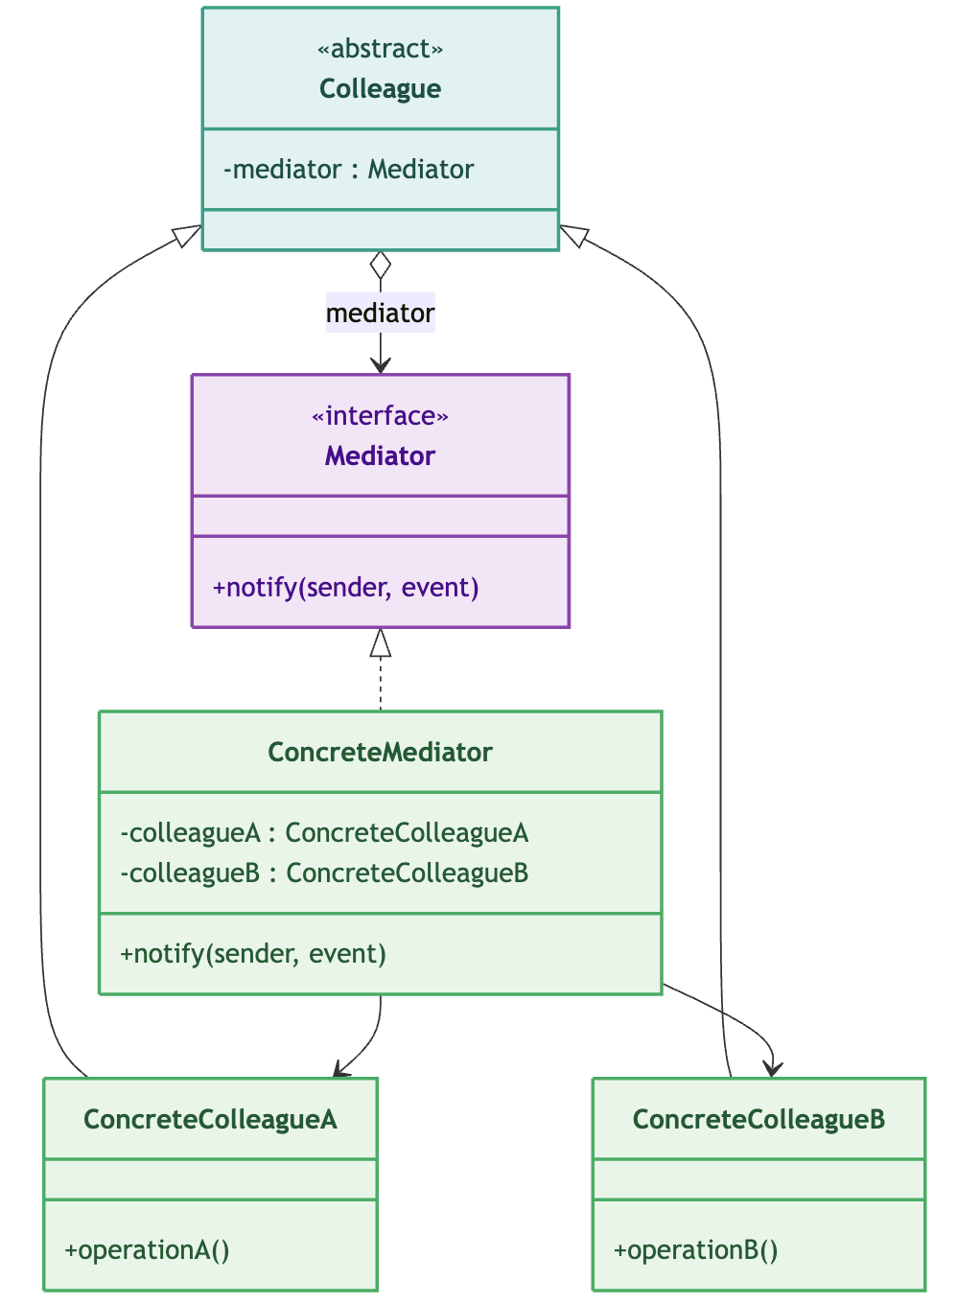
Mediator – Class Diagram

Slide 22
Mediator – Base classes
public interface Mediator {
void notify(Colleague sender, String event);
}
public abstract class AbstractMediator implements Mediator {
private final List<Colleague> colleagues = new ArrayList<>();
public void addColleague(Colleague colleague) {
if (!colleagues.contains(colleague)) colleagues.add(colleague);
}
public int colleagueCount() { return colleagues.size(); }
protected List<Colleague> otherColleagues(Colleague sender) {
List<Colleague> others = new ArrayList<>(colleagues);
others.remove(sender);
return others;
}
public void removeColleague(Colleague colleague) {
colleagues.remove(colleague);
}
public List<Colleague> getColleagues() {
return Collections.unmodifiableList(colleagues);
}
/** Broadcasts the event to every colleague except the sender. */
@Override
public void notify(Colleague sender, String event) {
for (Colleague c : otherColleagues(sender)) c.onEvent(event);
}
}
public abstract class Colleague {
private Mediator mediator;
public void setMediator(Mediator mediator) {
this.mediator = mediator;
// Colleagues NEVER hold references to other Colleagues
}
/** Sends a request to the mediator. */
public final void notify(String event) {
if (mediator == null) {
throw new IllegalStateException("No mediator attached");
}
mediator.notify(this, event);
}
/** Reacts to an event propagated by the mediator. */
public abstract void onEvent(String event);
}
public class ConcreteColleague extends Colleague {
@Override
public void onEvent(String event) {
System.out.println(
"[ColleagueA] reacting to: " + event);
}
}

Slide 23
Mediator – Air Traffic Control
public class Tower extends AbstractMediator {
public void register(Aircraft a) {
a.setMediator(this);
}
@Override
public void notify(Colleague sender, String event) {
Aircraft req = (Aircraft) sender;
if ("LAND".equals(event)) {
addColleague(req);
System.out.println(
"[Tower] " + req.getCallsign() + " in queue ("
+ colleagueCount() + " waiting).");
}
}
public void clearNext() {
if (colleagueCount() == 0) {
System.out.println("[Tower] runway clear, no traffic.");
return;
}
Aircraft next = (Aircraft) getColleagues().get(0);
removeColleague(next);
for (Colleague c : getColleagues()) {
c.onEvent("HOLD");
}
System.out.println(
"[Tower] clearing " + next.getCallsign() + " to land.");
next.onEvent("CLEARED");
}
}
public class Aircraft extends Colleague {
private final String callsign;
private boolean landed = false;
public Aircraft(String callsign) {
this.callsign = callsign;
}
public String getCallsign() { return callsign; }
public void requestLanding() {
notify("LAND"); // only way out: to the mediator
}
@Override
public void onEvent(String event) {
switch (event) {
case "CLEARED":
landed = true;
System.out.println(callsign + ": cleared to land.");
break;
case "HOLD":
System.out.println(
callsign + ": holding, stay on course.");
break;
default:
System.out.println(
callsign + ": unknown event " + event);
}
}
public boolean isLanded() { return landed; }
}

Slide 24
Mediator – Air Traffic Control
public class TowerDemo {
public static void main(String[] args) {
System.out.println("=== Tower / Aircraft (Mediator) ===");
Tower tower = new Tower();
Aircraft a1 = new Aircraft("DAL101");
Aircraft a2 = new Aircraft("UAL202");
Aircraft a3 = new Aircraft("BAW303");
tower.register(a1);
tower.register(a2);
tower.register(a3);
System.out.println("\n-- Three aircraft request landing --");
a1.requestLanding();
a2.requestLanding();
a3.requestLanding();
System.out.println("\n-- Tower clears them one at a time --");
tower.clearNext();
tower.clearNext();
tower.clearNext();
}
}

Slide 25
Mediator – Chat program

Slide 26
Mediator – Pros and cons
Advantages:
Loose coupling: colleagues depend only on the mediator interface; the dependency graph is a star, not a complete graph (n+1 vs. n·(n−1)/2).
Single point of coordination: interaction rules live in one class — easier to understand, test, and change.
Open/Closed at the interaction level: new participants are added without touching existing colleagues.
Substitutable policies: the same colleagues can be coordinated by different mediators (broadcast vs. moderated; matching vs. auction).
Simplifies complex interactions: multi-party rules (matching, cross-validation) become ordinary method bodies instead of scattered if/instanceof spaghetti.
Disadvantages:
Mediator bloat (god object): if everything is pushed into the mediator, it becomes a new coupling hotspot — now O(n) instead of O(n²), and hard to test.
Runtime indirection: a request travels colleague → mediator → colleague; the flow is less obvious than a direct call (mitigated by good naming and sequence diagrams).
Concurrency: if colleagues raise events from different threads, the mediator's state (registry, order book) needs explicit synchronization — the pattern does not solve thread safety for you.

Slide 27
State - Problem
Consider an object whose behavior depends on one or more internal conditions (a light that is red/green/yellow, a document that is draft/review/approved, an order that is pending/paid/shipped).
The naive implementation suffers from:
Conditional statements dependent on state: every method contains if (state == X) ... else if (state == Y) ... blocks. Adding a new state means touching every method — the class violates the Open/Closed Principle.
States and transitions scattered across methods: there is no single place where you can see from state A, event E leads to state B. The transition logic is implicit and easy to get wrong (e.g., forgetting that a delivered order cannot be cancelled).
Impossible or awkward to represent states as objects: when the same object must exhibit different behaviors in different states — until you separate the behavior into dedicated classes.
State-specific sub-behaviors: often each state needs its own auxiliary logic (validation, side effects, logging). With conditionals this logic is interleaved with unrelated code; with State it lives inside the state class that owns it.
Solution: instead of encoding what to do as a function of a state variable scattered through if/else or switch statements, you promote each state to a first-class object. The context delegates every request to the current state object, and it is the state object itself that decides what happens — including whether (and to which) state the system transitions next.

Slide 28
State - Usage
When to use it
Behavior varies significantly per state
Transitions are event-driven and non-trivial
You need to enforce valid transitions - Illegal transitions should be loud failures, not silent no-ops; this is testable and self-documenting.
New states will be added over time
When not to use it
Very few states (2–3) with simple behavior
States are pure data flags with no distinct behavior
The "state" is chosen by the client, not by internal transitions

Slide 29
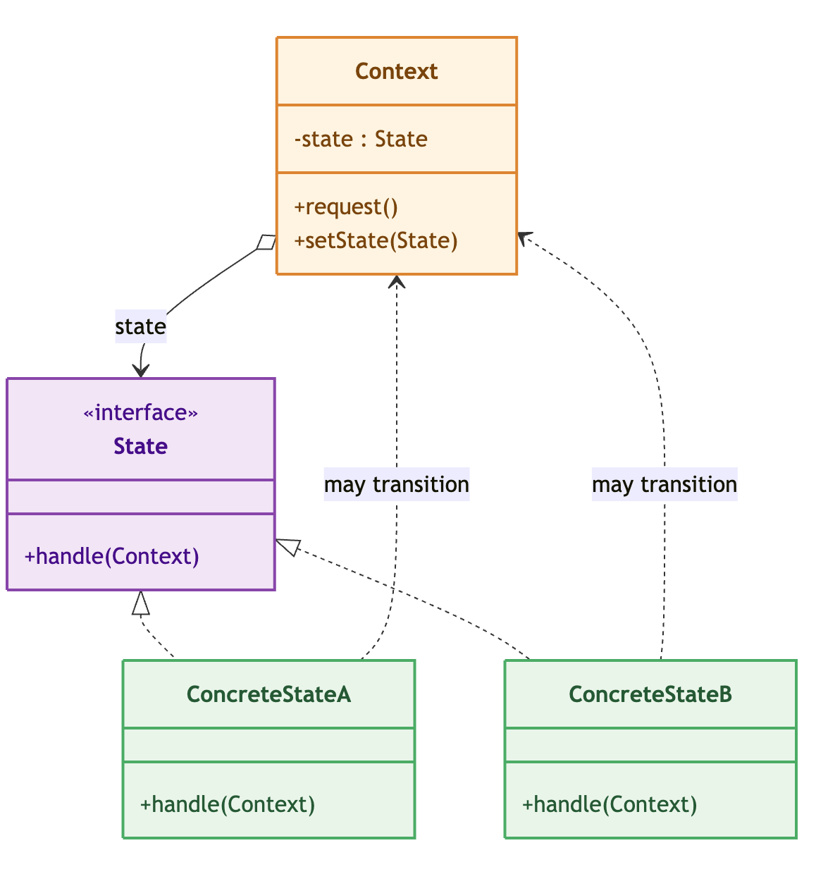
State – Class Diagram

Slide 30
State – The Pattern
public interface State {
void handle(Context context);
String getName();
}
public class Context {
private State currentState;
public void setState(State newState) { // called BY state objects
System.out.printf("Transition: %s → %s%n",
currentState.getName(), newState.getName());
this.currentState = newState;
}
public void request() { // called BY clients
currentState.handle(this); // pure delegation
}
}
public class ConcreteStateA implements State {
@Override
public void handle(Context context) {
System.out.println("[StateA] Executing logic...");
context.setState(new ConcreteStateB()); // triggers its own replacement
}
}

Slide 31
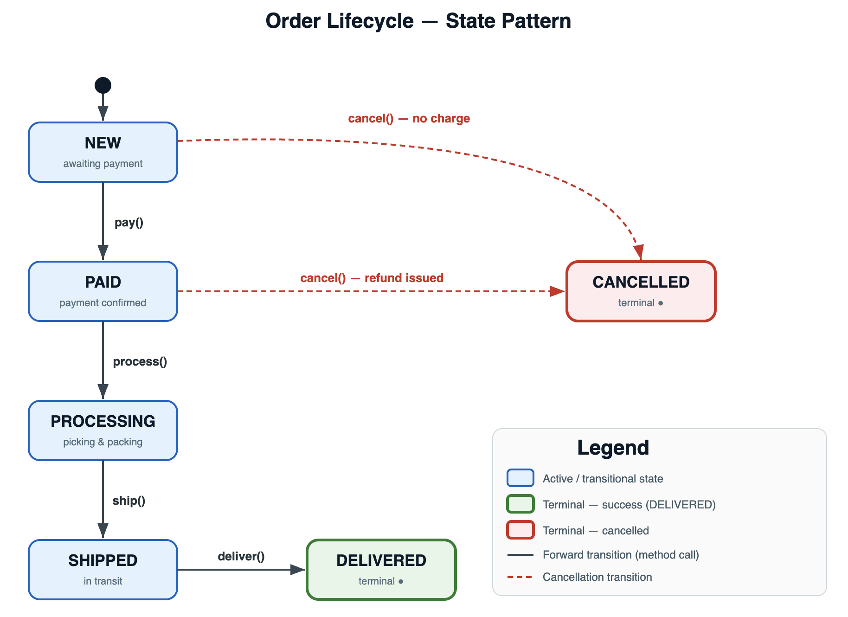
State – Order processing – State diagram

Slide 32
State – Order Processing – The state interface and the consumer
public class Order {
private static final DateTimeFormatter FMT =
DateTimeFormatter.ofPattern("HH:mm:ss");
private final String orderId;
private final double total;
private OrderState currentState;
private final List<String> auditLog = new ArrayList<>();
public Order(String orderId, double total) {
this.orderId = orderId;
this.total = total;
this.currentState = new NewOrderState();
log("Order created — total: $" + String.format("%.2f", total));
System.out.printf(" [Order %s] Created. Total: $%.2f State: %s%n",
orderId, total, currentState.getName());
}
// ── Operations (delegate to current state) ────────────────────────────
public void pay(String paymentRef) { currentState.pay(this, paymentRef); }
public void process() { currentState.process(this); }
public void ship(String trackingCode) { currentState.ship(this, trackingCode); }
public void deliver() { currentState.deliver(this); }
public void cancel(String reason) { currentState.cancel(this, reason); }
// ── State transition (called by state objects) ────────────────────────
public void setState(OrderState newState) {
this.currentState = newState;
}
// ── Accessors ─────────────────────────────────────────────────────────
public String getOrderId() { return orderId; }
public double getTotal() { return total; }
public OrderState getCurrentState() { return currentState; }
public boolean isTerminal() { return currentState.isTerminal(); }
public void showStatus() {
System.out.printf(" [Order %s] Status: %-12s Total: $%.2f Terminal: %b%n",
orderId, currentState.getName(), total, isTerminal());
}
}
public interface OrderState {
void pay(Order order, String paymentRef);
void process(Order order);
void ship(Order order, String trackingCode);
void deliver(Order order);
void cancel(Order order, String reason);
String getName();
boolean isTerminal();
}

Slide 33
State – Order Processing – The states - 1
public class CancelledState implements OrderState {
@Override public void pay(Order o, String r)
{ System.out.println("[CANCELLED] Order is cancelled."); }
@Override public void process(Order o)
{ System.out.println("[CANCELLED] Order is cancelled."); }
@Override public void ship(Order o, String t)
{ System.out.println("[CANCELLED] Order is cancelled."); }
@Override public void deliver(Order o)
{ System.out.println("[CANCELLED] Order is cancelled."); }
@Override public void cancel(Order o, String r)
{ System.out.println("[CANCELLED] Already cancelled."); }
@Override public String getName()
{ return "CANCELLED"; }
@Override public boolean isTerminal()
{ return true; }
}
public class NewOrderState implements OrderState {
@Override
public void pay(Order order, String paymentRef) {
order.log("Payment received: " + paymentRef);
System.out.printf("[NEW] Payment accepted: %s%n", paymentRef);
order.setState(new PaidState());
}
@Override
public void cancel(Order order, String reason) {
order.log("Cancelled (no charge): " + reason);
System.out.printf("[NEW] Cancelled: %s (no charge)%n", reason);
order.setState(new CancelledState());
}
@Override public void process(Order o)
{ System.out.println("[NEW] Pay first."); }
@Override public void ship(Order o, String t)
{ System.out.println("[NEW] Pay and process first."); }
@Override public void deliver(Order o)
{ System.out.println("[NEW] Not yet shipped."); }
@Override public String getName() { return "NEW"; }
@Override public boolean isTerminal() { return false; }
}
public class DeliveredState implements OrderState {
@Override public void pay(Order o, String r)
{ System.out.println("[DELIVERED] Order already completed."); }
@Override public void process(Order o)
{ System.out.println("[DELIVERED] Order already completed."); }
@Override public void ship(Order o, String t)
{ System.out.println("[DELIVERED] Order already completed."); }
@Override public void deliver(Order o)
{ System.out.println("[DELIVERED] Already delivered."); }
@Override public void cancel(Order o, String r)
{ System.out.println("[DELIVERED] Cannot cancel — already delivered”) }
@Override public String getName()
{ return "DELIVERED"; }
@Override public boolean isTerminal()
{ return true; }
}

Slide 34
State – Order Processing – The states - 2
public class PaidState implements OrderState {
@Override
public void process(Order order) {
order.log("Order entered processing/fulfilment queue");
System.out.println("[PAID] Order queued for processing/fulfilment.");
order.setState(new ProcessingState());
}
@Override
public void cancel(Order order, String reason) {
order.log("Cancelled (refund issued): " + reason);
System.out.printf("[PAID] Cancelled: %s (refund: $%.2f)%n",
reason, order.getTotal());
order.setState(new CancelledState());
}
@Override public void pay(Order o, String r)
{ System.out.println("[PAID] Already paid."); }
@Override public void ship(Order o, String t)
{ System.out.println("[PAID] Process order first."); }
@Override public void deliver(Order o)
{ System.out.println("[PAID] Not yet shipped."); }
@Override public String getName()
{ return "PAID"; }
@Override public boolean isTerminal()
{ return false; }
}
public class ProcessingState implements OrderState {
@Override
public void ship(Order order, String trackingCode) {
order.log("Shipped — tracking: " + trackingCode);
System.out.printf(" [PROCESSING] Shipped. Tracking: %s%n", trackingCode);
order.setState(new ShippedState(trackingCode));
}
@Override
public void cancel(Order order, String reason) {
System.out.println("[PROCESSING] Cannot cancel — items already being packed.");
}
@Override public void pay(Order o, String r)
{ System.out.println("[PROCESSING] Already paid."); }
@Override public void process(Order o)
{ System.out.println("[PROCESSING] Already processing."); }
@Override public void deliver(Order o)
{ System.out.println("[PROCESSING] Not yet shipped."); }
@Override public String getName() { return "PROCESSING"; }
@Override public boolean isTerminal() { return false; }
}

Slide 35
State – Order Processing – The states – 3 - Application
public class OrderDemo {
public static void main(String[] args) {
// ── Scenario 1: Happy path ─────────────────────────────────────────
System.out.println("Scenario 1: Happy path — full lifecycle");
Order o1 = new Order("ORD-001", 149.99);
o1.pay("PAY-REF-ABC123");
o1.process();
o1.ship("DHL-9876543210");
o1.deliver();
o1.showStatus();
o1.printAuditLog();
// ── Scenario 2: Cancelled before payment ──────────────────────────
System.out.println("Scenario 2: Cancel before payment (no charge)");
Order o2 = new Order("ORD-002", 59.90);
o2.cancel("Customer changed mind");
o2.pay("PAY-LATE"); // rejected — already cancelled
o2.showStatus();
// ── Scenario 3: Cancelled after payment ───────────────────────────
System.out.println("Scenario 3: Cancel after payment (refund issued)");
Order o3 = new Order("ORD-003", 299.00);
o3.pay("PAY-REF-XYZ789");
o3.cancel("Item out of stock");
o3.showStatus();
// ── Scenario 4: Attempt invalid operations ─────────────────────────
System.out.println("Scenario 4: Invalid operation attempts");
Order o4 = new Order("ORD-004", 75.00);
o4.ship("EARLY-SHIP"); // rejected — not paid yet
o4.pay("PAY-OK");
o4.ship("EARLY-SHIP-2"); // rejected — not processed yet
o4.process();
o4.cancel("Too late?"); // rejected — already processing
o4.ship("UPS-555");
o4.cancel("In transit"); // rejected — already shipped
o4.deliver();
o4.cancel("After delivery"); // rejected — terminal
o4.showStatus();
}
}
public class ShippedState implements OrderState {
private final String trackingCode;
public ShippedState(String trackingCode) {
this.trackingCode = trackingCode;
}
@Override
public void deliver(Order order) {
order.log("Delivered. Tracking was: " + trackingCode);
System.out.printf(”
[SHIPPED] Delivered! (was tracking: %s)%n", trackingCode);
order.setState(new DeliveredState());
}
@Override
public void cancel(Order order, String reason) {
System.out.println(”
[SHIPPED] Cannot cancel — package is in transit.");
}
@Override public void pay(Order o, String r)
{ System.out.println("[SHIPPED] Already paid."); }
@Override public void process(Order o)
{ System.out.println("[SHIPPED] Already processed."); }
@Override public void ship(Order o, String t)
{ System.out.println("[SHIPPED] Already shipped.”);
@Override public String getName() { return "SHIPPED"; }
@Override public boolean isTerminal() { return false; }
}

Slide 36
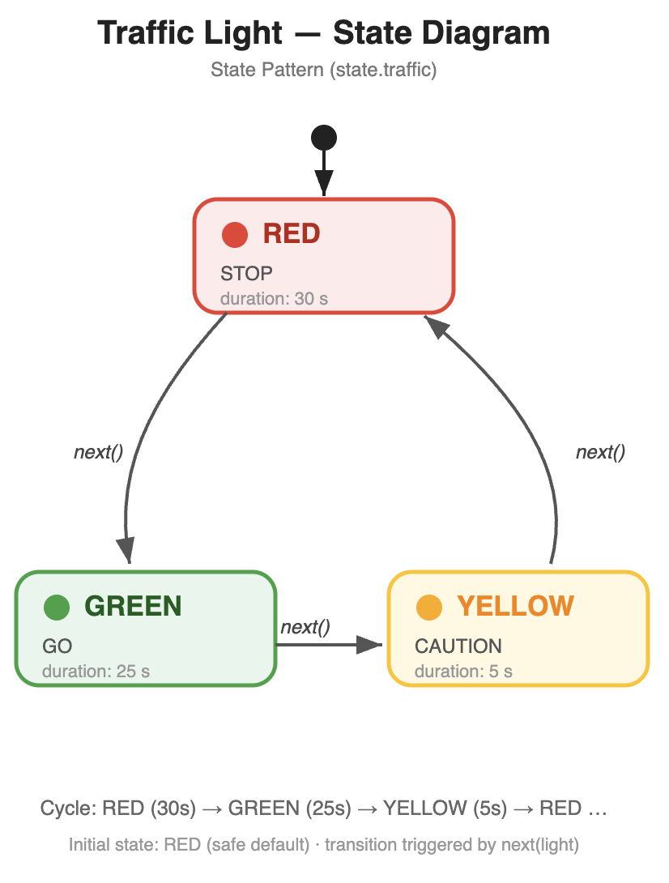
State – Traffic Light

Slide 37
State – Pros and cons
Advantages
Encapsulates state-specific behavior: each state's logic lives in one class
Makes states and transitions explicit: the set of states is the set of concrete classes
States are substitutable objects: think about testing opportunities
Easy to extend: adding a state = adding one class, no need to touch other states
Avoids a huge conditional object: the alternative — one class with a state field and giant conditionals — grows quadratically with the number of states × events
Disadvantages
Many small classes: A 5-state machine means 5+ classes plus interface/context; for trivially simple state logic this can feel like overkill (rule of thumb: use State when behavior differs per state, not merely the value)
Coupling risk: if states hold context references - circular dependencies and harder reuse
Context data access: passing everything as parameters can make state method signatures bloated

Slide 38
Strategy - Problem
Suppose a TextFormatter must support left, center, and right alignment:
public String format(String text, int width) {
switch (alignment) { // alignment is an enum or int field
case LEFT: return padRight(text, width);
case CENTER: return padBoth(text, width);
case RIGHT: return padLeft(text, width);
}
}
Problems with this approach:
Combinatorial explosion: if the class also varies by another dimension (e.g., font style), every combination needs its own subclass or a nested conditional — the classic "class explosion" warning from GoF.
Closed for extension: adding a new algorithm (justified alignment, quicksort, loyalty discount) requires modifying existing code — a violation of the Open/Closed Principle.
Testing difficulty: all branches live in one class; each branch must be tested through the whole class.
Solution: extract the varying behavior into its own hierarchy of classes that share a common interface. The original class (the Context) keeps a reference to that interface and delegates to it. The algorithm can now vary independently of the Context and of the client.

Slide 39
Strategy
When to use it
You have a family of interchangeable algorithms
The algorithm must be swappable at runtime (testing too)
New algorithms will be added without modifying existing code
When not to use it
There are only two (or three) options and they will never change
The "algorithms" are really just parameter values
The strategies share heavy mutable state with the Context
Selecting the strategy is itself complex and context-dependent

Slide 40
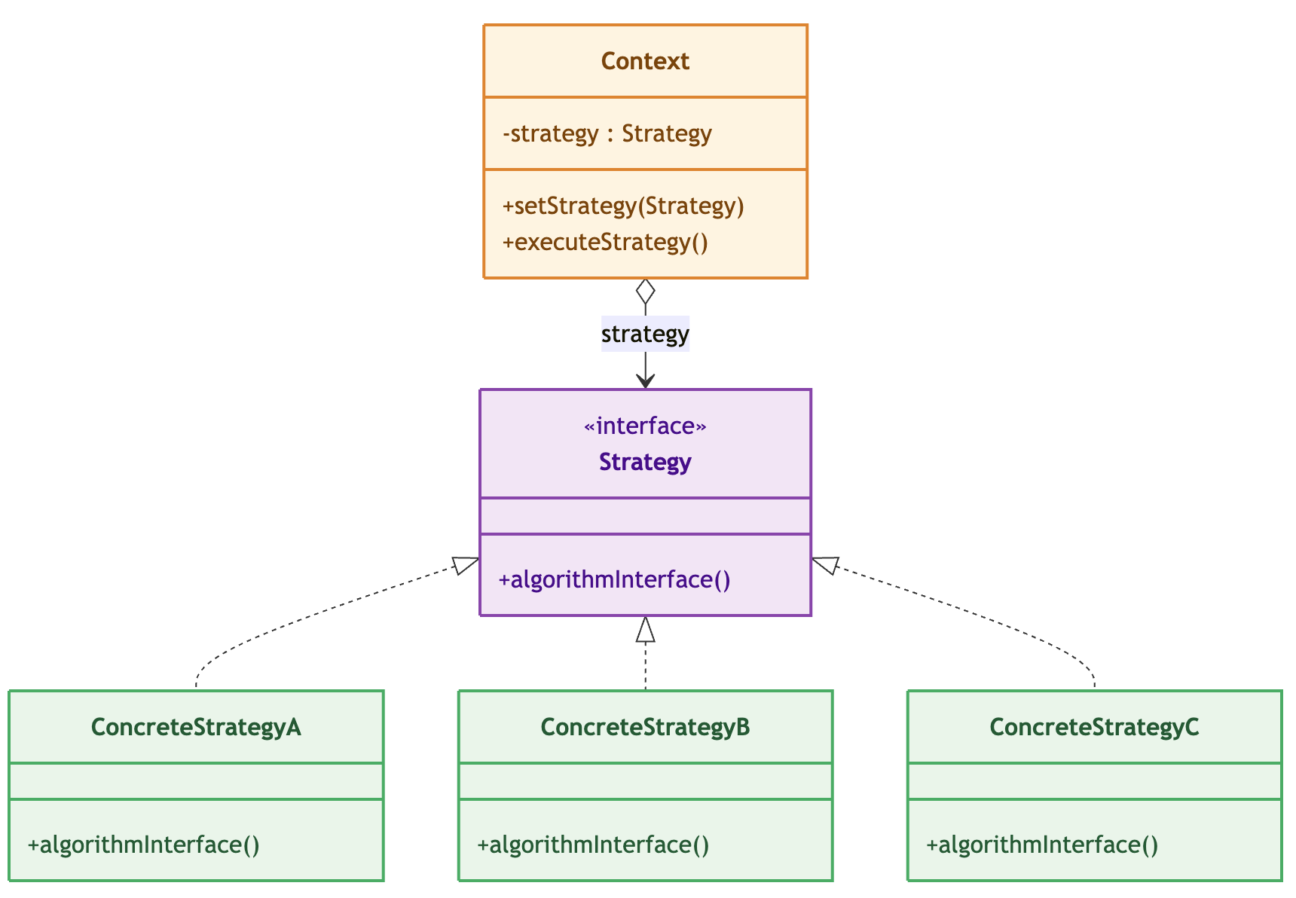
Strategy – Class Diagram

Slide 41
Strategy – Payment system – Interface and implementers
public interface PaymentStrategy {
public boolean pay(double amount, String currency);
}
public class BankTransferPayment implements PaymentStrategy {
private final String accountHolder;
private final String iban;
public BankTransferPayment(String accountHolder, String iban) {
}
@Override
public boolean pay(double amount, String currency) {
// … …
}
}
public class BitcoinPayment implements PaymentStrategy {
private final String walletAddress;
public BitcoinPayment(String walletAddress) {
}
@Override
public boolean pay(double amount, String currency) {
// …
}
}

Slide 42
Strategy – Payment system – Application
public class PaymentProcessor {
private PaymentStrategy strategy;
public PaymentProcessor(PaymentStrategy strategy, …) {
this.strategy = strategy;
this.defaultCurrency = currency;
}
public void setStrategy(PaymentStrategy strategy) {
this.strategy = strategy;
}
public boolean processPayment(double amount) {
return processPayment(amount, defaultCurrency);
}
public boolean processPayment(
double amount, String currency) {
boolean ok = strategy.pay(amount, currency);
if (ok) {
…
} else {
…
}
return ok;
}
}
public class PaymentDemo {
public static void main(String[] args) {
PaymentProcessor processor = new PaymentProcessor(
new BitcoinPayment(”…"));
processor.processPayment(299.00);
processor.setStrategy(
new BankTransferPayment("Alice Mueller GmbH",
"DE89370400440532013000", "COBADEFFXXX"));
processor.processPayment(4_750.00);
}
}

Slide 43
Strategy – Sorting

Slide 44
Strategy – Pros and cons
Advantages
Runtime flexibility: the algorithm can be changed at runtime (if the Context exposes a setter) without recompiling or modifying the Context.
No conditional branching: each strategy is a self-contained class — easy to unit-test in isolation.
Reuse across levels: the same operation interface can be implemented at different levels of detail.
State-based alternative: instead of passing data from Context to Strategy, the Context can pass itself to the strategy, letting strategies share state through callbacks.
Disadvantages
The client must know which ConcreteStrategy to instantiate — knowledge of the concrete classes is required somewhere (often in a factory or config).
More objects than an if/else chain (mitigated by reusing singletons for stateless strategies, or by lazy creation).
Communication between Context and Strategy can be awkward when the algorithm needs many pieces of context data (long parameter lists, or giving the strategy a back-reference to the Context).

Slide 45
Command - Problem
Let’s assume we’re developing UI actions for our widgets.
Without the pattern, a UI button (or any sender) is hard-wired to a concrete service class:
The sender (button, menu entry, event handler) must know the receiver's concrete type → tight coupling.
You cannot change what a button does without changing the button's code.
You cannot queue, batch, log, or reverse requests, because a request is just a method call — it has no identity in time.
Solution: introduce an intermediate object that represents the request. The sender only knows the abstract Command type; the receiver only knows how to do its job; and the concrete command is the small adapter that binds them together.

Slide 46
Command - Usage
When to use it
Decoupling Requester from Executor
You need Undo / Redo
You need Queuing, Logging, or Deferred Execution, or Transactional / Composite behavior
You need to parameterize with different requests
When not to use it
The call is simple and direct
No need for Undo, Queuing, Logging, or Deferred Execution
You actually need Strategy, not Command – in Command the invocation lifecycle matters (queue, undo, log), in
Strategy the computation itself matters (different algorithms for the same problem)

Slide 47
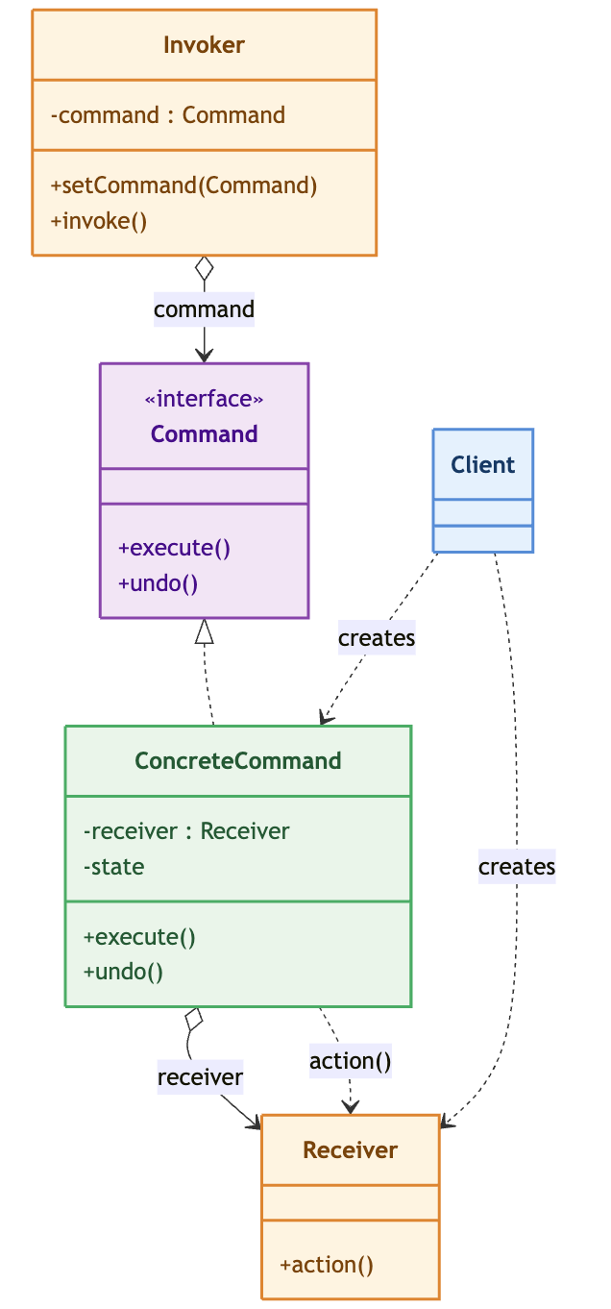
Command – Class Diagram

Slide 48
Command – Base classes
public class Invoker {
private Command command;
public void setCommand(Command cmd) { this.command = cmd; }
public void press() {
System.out.println("[Invoker] triggered");
command.execute(); // no knowledge of Receiver
}
}
public interface Command {
void execute();
void undo(); // optional
}
public class Receiver {
public void actionA(String details) {
System.out.printf("[Receiver] actionA — %s%n", details);
}
public void actionB(…) {
}
}
Receiver receiver = new Receiver();
Command cmd = new ConcreteCommand(receiver, "start");
Invoker invoker = new Invoker();
invoker.setCommand(cmd);
invoker.press();
public class ConcreteCommand implements Command {
private final Receiver receiver;
private final String params;
public ConcreteCommand(Receiver receiver, String params) {
this.receiver = receiver;
this.params = params;
}
@Override public void execute() { receiver.actionA(params); }
@Override public void undo() { receiver.actionB("reverse: " + params); }
}

Slide 49
Command – Light – Receiver and commands
class TurnOnCommand implements Command {
private Light light;
public TurnOnCommand(Light light) {
this.light = light;
}
public void execute() {
light.turnOn();
}
public void undo() {
light.turnOff(); // the opposite of "on" is "off"
}
}
class Light { // THE RECEIVER
private boolean on = false;
public void turnOn() {
on = true;
System.out.println("Light is ON");
}
public void turnOff() {
on = false;
System.out.println("Light is OFF");
}
}
class TurnOffCommand implements Command {
private Light light;
public TurnOffCommand(Light light) {
this.light = light;
}
public void execute() {
light.turnOff();
}
public void undo() {
light.turnOn(); // the opposite of "off" is "on"
}
}

Slide 50
Command – Light – Macro command
class MacroCommand implements Command {
private Command[] commands;
public MacroCommand(Command... commands) {
this.commands = commands;
}
public void execute() {
for (Command c : commands) {
c.execute();
}
}
public void undo() {
// undo in REVERSE order, like a stack
for (int i = commands.length - 1; i >= 0; i--) {
commands[i].undo();
}
}
}
Which DPs do this recall?

Slide 51
Command – Light – Invoker and Demo
public class Main {
public static void main(String[] args) {
Light light = new Light();
// --- Basic usage: one button, one command ---
RemoteControl remote = new RemoteControl();
remote.setCommand(new TurnOnCommand(light));
remote.pressButton(); // -> Light is ON
remote.pressUndo(); // -> Light is OFF
System.out.println("-----");
// --- Macro usage: ONE button does SEVERAL things ---
// “turn off, turn on, then turn off, then
// turn on again” as a single action
Command macro = new MacroCommand(
new TurnOffCommand(light),
new TurnOnCommand(light),
new TurnOffCommand(light),
new TurnOnCommand(light)
);
remote.setCommand(macro); // the button now holds the macro
remote.pressButton(); // runs all four in order
remote.pressUndo(); // undoes all four, in reverse
}
}
class RemoteControl { // THE INVOKER
private Command slot; // one button = one slot
public void setCommand(Command c) {
this.slot = c;
}
public void pressButton() {
slot.execute();
}
public void pressUndo() {
slot.undo();
}
}

Slide 52
Command – Job queue

Slide 53
Command – Pros and cons
Advantages
Decoupling of sender and receiver: the invoker depends only on the Command interface; the receiver never hears about the invoker. Either side can evolve independently.
Parameterizing clients with requests: a UI slot holds a Command; swapping behavior means installing a different object — no code change.
Queuing and batching of requests: Commands are objects → they can sit in a queue (decoupling in time: request made at T, executed at T+n) or be grouped into a macro/composite command.
Undo/redo for free-ish: because the request object survives after execution, an invoker can keep a history stack and call undo()/execute() again. The command stores whatever state it needs to reverse itself (a lightweight Memento).
Transactional commands: a macro can execute several commands as one unit, with reverse-order undo.
Disadvantages
More classes: every request becomes a class; for trivial one-shot calls this is overhead.
System complexity: the indirection layer (command object between sender and receiver) is harder to follow in small systems — the pattern pays off when requests need to be stored, queued, logged, or reversed.

Slide 54
Template Method - Problem
Many algorithms share a fixed high-level structure composed of invariant steps that must always execute in a specific order, but include variable sub-steps that differ based on context or requirements.
Without a mechanism to enforce this structure while permitting customization:
Developers implement these algorithms separately in multiple classes → code duplication
The algorithm's integrity is not enforced → inconsistent implementations
Adding new variants requires understanding the entire algorithm → maintenance burden
Solution: provides a skeleton in a base class that outlines the algorithm's invariant sequence, deferring the variable sub-steps to subclasses for redefinition without altering the overall flow. This ensures consistency in the algorithm's execution while allowing flexibility for specialized behaviors.

Slide 55
Template Method
When to use it
Fixed skeleton, variable details: the algorithm's sequence of steps is invariant, but individual steps differ across implementations
You want to enforce a protocol: the base class guarantees that certain steps always happen (e.g., resource acquisition before work, cleanup after). Subclasses cannot skip or reorder them.
Shared code reduction
When not to use it
The algorithm structure itself varies
Runtime swapping of behavior is required
Deep inheritance hierarchy is emerging: Template Method works best when the hierarchy is linear and shallow
Need to combine multiple variants

Slide 56
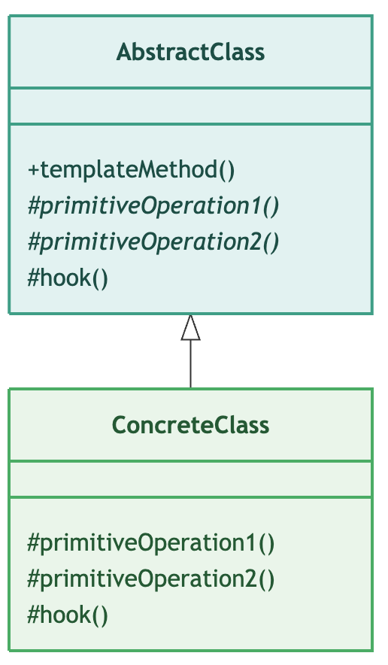
Template Method – Class Diagram

Slide 57
Template Method – Cafeteria – Abstract base class
public abstract class HotBeverage {
/** THE TEMPLATE METHOD — sequence is fixed, individual steps vary. */
public final void prepareRecipe() {
System.out.println();
boilWater();
brew();
pourInCup();
if (customerWantsCondiments()) {
addCondiments();
}
}
// ── Concrete steps — invariant across all beverages ──────────────────
protected void boilWater() {
//
}
protected void pourInCup() {
//
}
// ── Abstract steps — each beverage brews and adds differently ─────────
/** Step 2: Brew the beverage (steep tea, drip coffee, heat chocolate …) */
protected abstract void brew();
/** Step 4: Add condiments (milk, sugar, cream, marshmallows …) */
protected abstract void addCondiments();
// ── Hooks ─────────────────────────────────────────────────────────────
/** Hook: override to suppress condiments (e.g. when user says "black"). */
protected boolean customerWantsCondiments() { return true; }
/** Human-readable name used in the "ready" message. */
public abstract String getName();
}

Slide 58
Template Method – Cafeteria – Subclasses
public class HotChocolate extends HotBeverage {
/** Override the shared concrete step — chocolate uses milk, not water. */
@Override
protected void boilWater() {
//
}
@Override
protected void brew() {
//
}
@Override
protected void addCondiments() {
//
}
@Override
public String getName() { return "Hot Chocolate with Cream"; }
}
public class Tea extends HotBeverage {
@Override
protected void brew() {
//
}
@Override
protected void addCondiments() {
//
}
// customerWantsCondiments() → inherited true — lemon always added
@Override
public String getName() { return "Tea with Lemon"; }
}

Slide 59
Template Method – Cafeteria – Application
public class BeverageDemo {
public static void main(String[] args) {
HotBeverage[] orders = {
new Tea(),
new Coffee(true), // with milk & sugar
new Coffee(false), // black — condiment hook returns false
new HotChocolate(),
};
for (HotBeverage beverage : orders) {
System.out.printf("%n─── Preparing: %-30s ───%n", beverage.getName());
beverage.prepareRecipe();
}
}
}

Slide 60
Template Method – Data processing

Slide 61
Template Method – Pros and cons
Advantages
Code reuse: common algorithm logic is implemented once in the abstract class
Consistency: all subclasses follow the same algorithm structure
Controlled extension: subclasses can only customize designated points, not the overall flow
Open-Closed Principle: new variants are added via new subclasses without modifying existing code
Encapsulation: the algorithm's internal structure is hidden; clients see only the template method
Disadvantages
One extra class per variant: each algorithm step variation requires a new subclass
Backward references: the abstract class may need to reference subclass state (via this)
Limited runtime flexibility: variants are fixed at compile time; cannot swap algorithms dynamically
Hierarchy depth: deep hierarchies can make the pattern hard to maintain
Liskov Substitution risk: If a subclass cannot fully honor the template's contract, LSP is violated

Slide 62
Memento - Problem
Suppose a text editor must support Undo.
Why naive solution fails:
Client keeps copies of the state: (String oldText = editor.getText()): the client must know the internal representation of the editor → encapsulation broken; every client duplicates that knowledge.
Editor exposes a public getState()/setState() pair: any object can read and tamper with the internal state → invariants can be violated from outside.
Client computes an inverse operation (delete what was typed): works only for trivial, invertible operations; impossible for complex or multi-step changes.
Solution: move the knowledge of how to snapshot and restore inside the object itself, while letting other objects store the snapshot without being able to read or modify it.

Slide 63
Memento - Usage
When to use it
You need undo/redo with full state fidelity: the user action is complex, multi-step, or touches many fields — reconstructing the previous state from a log of operations would be fragile or impossible.
You must preserve encapsulation while allowing snapshots: the internal state is private, invariants are non-trivial (e.g. balance ≥ 0, graph connectivity), and you cannot safely expose a public getter that returns a mutable copy.
You need named checkpoints (save slots, milestones)
You need transactional rollback in business logic
When not to use it
The state is a simple value type (or already immutable)
You can undo by applying an inverse operation (Command pattern)
You need partial or granular undo: Memento is all-or-nothing per snapshot

Slide 64
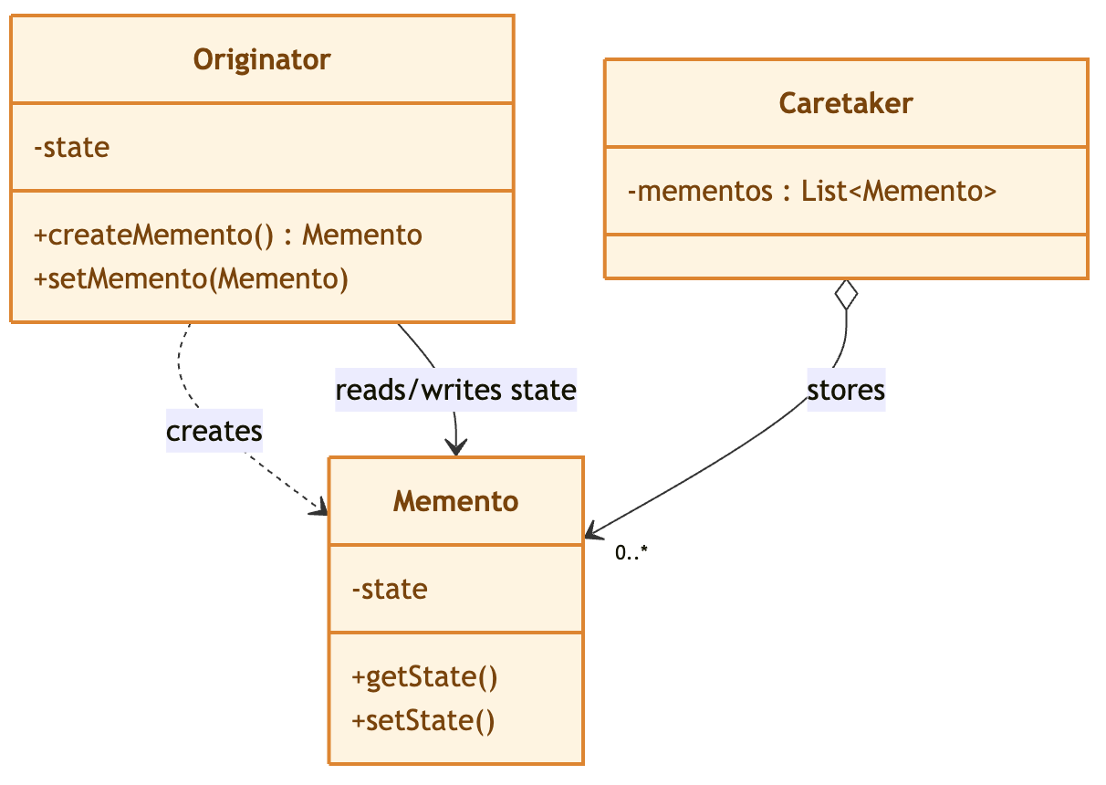
Memento – Class Diagram

Slide 65
Memento – The Pattern
// Package-private class — Caretaker in another package cannot access fields
class Memento {
private final String state;
Memento(String state) { // package-private constructor
this.state = state;
}
// package-private getter
String getState() { return state; }
@Override
public String toString() {
return "Memento[len=" + state.length() + "]";
}
}
public class Caretaker {
private final List<Memento> history = new ArrayList<>();
// stores opaque token
public void save() { history.add(originator.save()); }
public void undo() {
Memento m = history.remove(history.size() - 1);
// returns opaque token — cannot read it
originator.restore(m);
}
}
public class Originator {
private String state;
public Memento save() { // creates snapshot
return new Memento(state); // uses pkg-private constructor
}
public void restore(Memento m) { // restores from snapshot
this.state = m.getState(); // uses pkg-private getter
}
}

Slide 66
Memento – Text Editor – The Originator
public class TextEditor {
private StringBuilder content = new StringBuilder();
private int cursorPos = 0;
// ── Inner Memento ────────────────────────────────────────────────
public static final class EditorMemento {
private final String content; // ← PRIVATE — outer class can access
private final int cursorPos; // inner class fields directly
private final Instant savedAt;
private EditorMemento(String content, int cursorPos) {
this.content = content;
this.cursorPos = cursorPos;
this.savedAt = Instant.now();
}
// NARROW interface — ONLY this is public
public String getLabel() {
return "Snapshot at " + savedAt + " (len=" + content.length() + ")";
}
}
// ── Originator operations ────────────────────────────────────────
public EditorMemento save() {
return new EditorMemento(content.toString(), cursorPos);
}
public void restore(EditorMemento m) {
this.content = new StringBuilder(m.content); // accesses private field
this.cursorPos = m.cursorPos; // accesses private field
}
}

Slide 67
Memento – Text Editor – The Caretaker
public class EditorHistory {
private final Deque<TextEditor.EditorMemento> undoStack = new ArrayDeque<>();
private final Deque<TextEditor.EditorMemento> redoStack = new ArrayDeque<>();
// Called BEFORE each editing operation
public void snapshot() {
undoStack.push(editor.save());
redoStack.clear(); // ← new edit always clears redo branch
}
public boolean undo() {
if (undoStack.isEmpty()) return false;
redoStack.push(editor.save()); // save current for redo
editor.restore(undoStack.pop());
return true;
}
public boolean redo() {
if (redoStack.isEmpty()) return false;
undoStack.push(editor.save()); // save current for undo
editor.restore(redoStack.pop());
return true;
}
}
TextEditor editor = new TextEditor();
EditorHistory history = new EditorHistory(editor);
history.snapshot(); editor.type("Hello, World!"); // save before typing
history.snapshot(); editor.type(" Welcome to Java.");
history.snapshot(); editor.replaceFirst("World", "Universe");
history.snapshot(); editor.backspace(5);
editor.show("Current"); // "Hello, Universe! Welcome to Jav"
history.undo(); editor.show("Undo 1"); // restore before backspace
history.undo(); editor.show("Undo 2"); // restore before replace
history.redo(); editor.show("Redo 1"); // re-apply replace

Slide 68
Memento – Game save

Slide 69
Memento – Pros and cons
Advantages
Encapsulation is preserved: state knowledge stays inside the originator
Snapshots are immutable: no accidental mutation, safe to share references
The caretaker is fully pluggable (stack / map / list / disk), without touching originator or memento
Naturally supports undo, redo, multiple histories, and time-travel restore
Disadvantages
Every snapshot copies state, so long sessions with large objects can be expensive
The originator must guarantee its state is consistent at snapshot time (no half-applied transactions)
If the state contains references to mutable objects, the memento must deep-copy them, otherwise the immutable snapshot can change

Slide 70
Interpreter - Problem
When a problem occurs very frequently, it can be represented as a sentence in a simple Domain-Specific Language (DSL).
Hard-wiring all possible expressions directly into application code is:
Inflexible: commits the class to particular expressions
Unmaintainable: impossible to specify new expressions without modifying existing code
Violates OCP: classes are open for modification but not closed for extension
The Interpreter pattern solves this by:
Defining a grammar for the language via an Expression class hierarchy
Representing each sentence as an Abstract Syntax Tree (AST) of Expression instances
Interpreting a sentence by calling interpret() on the root of the AST

Slide 71
Interpreter - Usage
When to use it
The grammar is simple: the pattern's overhead (one class per symbol) is justified only for small grammars
You need to add new expression types without modifying existing code
The same AST structure must be interpreted in multiple contexts
You're building a DSL, rule engine, or query language
When not to use it
The grammar is complex: many rules, precedence, ambiguity => use a parser generator
You only need one fixed expression: just write the logic directly, the pattern adds indirection with no benefit
You need error recovery / partial parsing: the Interpreter pattern has no such machinery

Slide 72
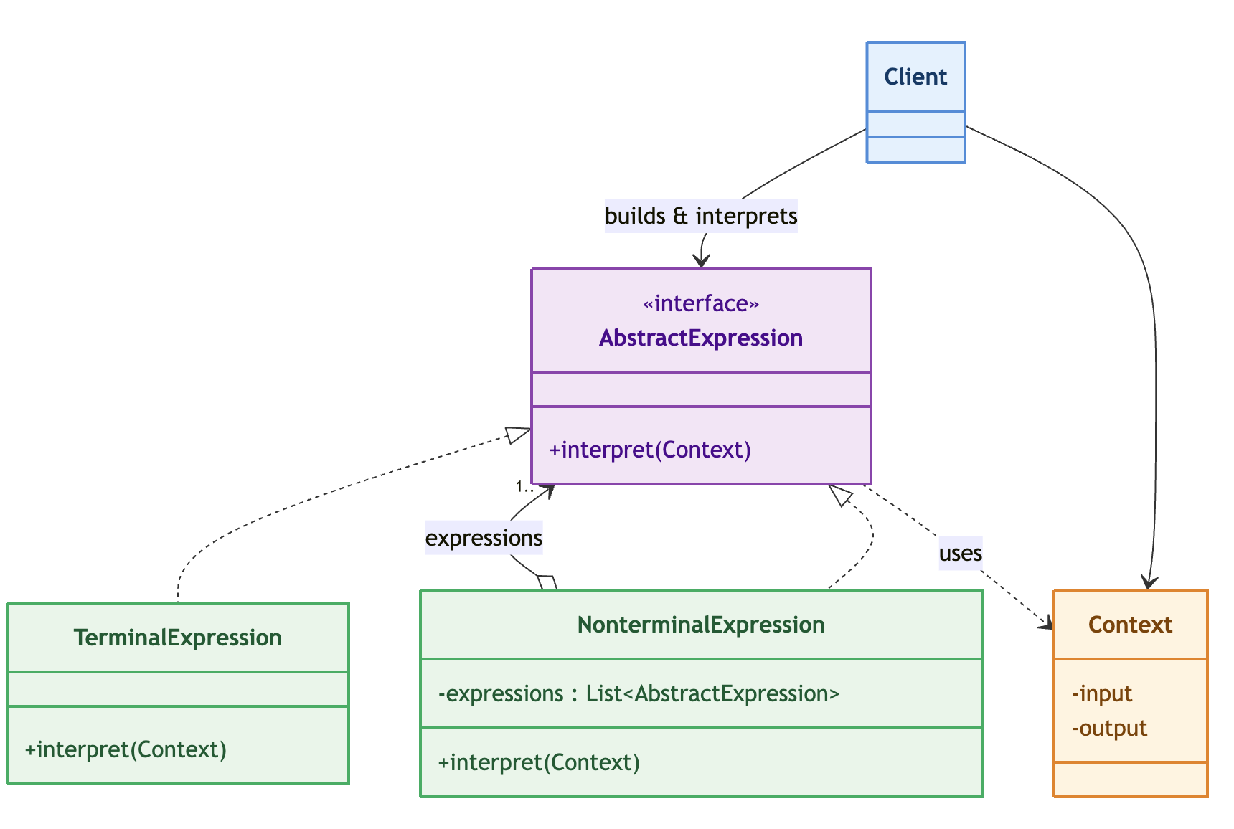
Interpreter – Class Diagram

Slide 73
Interpreter – Evaluate expressions
public class NTE implements Expression {
private final Expression left;
private final Expression right;
@Override
public int interpret(Context context) {
return left.interpret(context) + right.interpret(context);
}
@Override
public String toFormula() {
return "(" + left.toFormula() + " + " + right.toFormula() + ")";
}
}
public interface Expression {
int interpret(Context context);
String toFormula();
}
public class Context {
private final Map<String, Integer> variables =
new HashMap<>();
public void assign(String name, int value) {
variables.put(name, value); }
public int lookup(String name) {
return variables.get(name); }
}
Context ctx = new Context();
ctx.assign("x", 10); ctx.assign("y", 4); ctx.assign("z", 3);
// AST for: (x + y) + z
// NonTerminal(+)
// / \
// NonTerminal(+) Terminal(z)
// / \
// Terminal(x) Terminal(y)
Expression x = new TerminalExpression("x");
Expression y = new TerminalExpression("y");
Expression z = new TerminalExpression("z");
Expression root = new NonTerminalExpression(
new NonTerminalExpression(x, y), z);
System.out.println(root.toFormula()); // ((x + y) + z)
System.out.println(root.interpret(ctx)); // 17
public class TE implements Expression {
private final String variableName;
@Override
public int interpret(Context context) {
return context.lookup(variableName);
}
@Override
public String toFormula() { return variableName; }
}

Slide 74
Interpreter – Roman Numeral

Slide 75
Interpreter – Pros and cons
Advantages
Easy to extend: adding a new expression type requires only a new class
Composability: new sentences in the language can be built by composing existing terminal and non-terminal classes
Simple structure per rule: each production rule maps to exactly one class with a single interpret() method, this keeps each unit small, focused, and trivially testable in isolation
Natural recursive-descent fit: the pattern mirrors how a human reads a grammar: each non-terminal "knows" how to interpret its children recursively
No external dependencies: implemented in the language directly
Disadvantages
Class explosion: one class per terminal symbol + one per non-terminal
Poor performance and high memory overhead: tree-walking through virtual interfaces calls, slower than generated parsers
Tight coupling to the grammar shape: if the fundamental structure of the language changes, many node classes must be restructured

Slide 76
Visitor - Problem
You have a stable class hierarchy modeling an object structure (an AST, a shape catalog, a document tree), and over time you need more and more operations on it: evaluate, print, serialize, validate, count, render…
If each operation is implemented as a method of the element classes, then:
every new operation forces modification of every concrete element class
related logic (e.g., "how to serialize") gets scattered across many unrelated classes
element classes degenerate into god classes that know too much about every use case
Solution: split the design into two independent hierarchies:
The object structure: the Element hierarchy. Stable; it knows nothing about operations except how to welcome a visitor.
The operations: the Visitor hierarchy. Each concrete visitor implements exactly one operation, with one method per concrete element type

Slide 77
Visitor - Usage
When to use it
You have a complex object structure (tree, graph, composite) that is relatively stable in terms of its element types
You need many different operations on that same structure, and new ones keep appearing
You want to separate traversal policy from per-node behavior: the visitor owns the walk, elements only expose state
Operations are read-heavy (or at least don't restructure the tree).
When not to use it
The element hierarchy changes frequently (new types added/removed often): very new concrete element forces a new visit(...) method in every existing visitor
There are only a few operations (1–3): the ceremony of defining Element, Visitor, and multiple ConcreteVisitor classes outweighs the benefit, just add the methods directly on the element classes
The structure is flat or very small
Operations need to mutate the structure during traversal

Slide 78
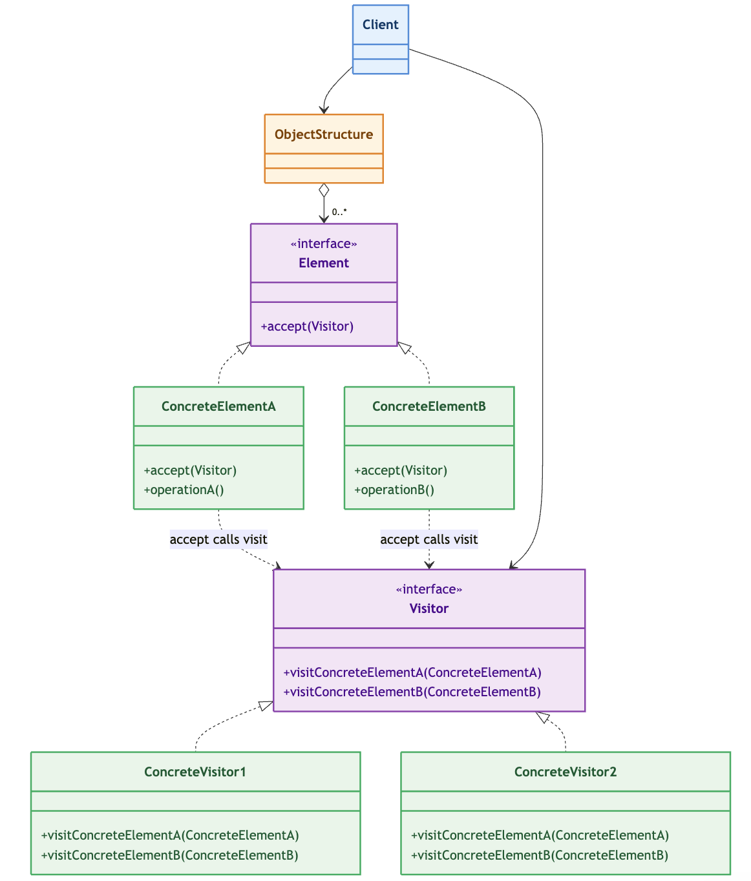
Visitor – Class Diagram

Slide 79
Visitor – Evaluate expressions - Visited
public class MultiplyExpr implements Expression {
private final Expression left;
private final Expression right;
public MultiplyExpr(Expression left, Expression right) {
this.left = left;
this.right = right;
}
public Expression getLeft() { return left; }
public Expression getRight() { return right; }
@Override
public void accept(ExpressionVisitor visitor) {
visitor.visit(this);
}
}
public interface Expression {
void accept(ExpressionVisitor visitor);
}
public class NumberExpr implements Expression {
private final double value;
public NumberExpr(double value) {
this.value = value;
}
public double getValue() { return value; }
@Override
public void accept(ExpressionVisitor visitor) {
visitor.visit(this);
}
@Override
public String toString() { return String.valueOf(value); }
}
public class AddExpr implements Expression {
private final Expression left;
private final Expression right;
public AddExpr(Expression left, Expression right) {
this.left = left;
this.right = right;
}
public Expression getLeft() { return left; }
public Expression getRight() { return right; }
@Override
public void accept(ExpressionVisitor visitor) {
visitor.visit(this);
}
}

Slide 80
Visitor – Evaluate expressions - Visitors
public interface ExpressionVisitor {
void visit(NumberExpr expr);
void visit(AddExpr expr);
void visit(MultiplyExpr expr);
}
public class PrettyPrintVisitor implements ExpressionVisitor {
private final Deque<String> stack = new ArrayDeque<>();
@Override
public void visit(NumberExpr expr) {
// Format: drop trailing .0 for whole numbers
double v = expr.getValue();
stack.push(v == Math.floor(v) && !Double.isInfinite(v)
? String.valueOf((long) v)
: String.valueOf(v));
}
@Override
public void visit(AddExpr expr) {
expr.getLeft().accept(this);
expr.getRight().accept(this);
String right = stack.pop();
String left = stack.pop();
stack.push("(" + left + " + " + right + ")");
}
@Override
public void visit(MultiplyExpr expr) {
expr.getLeft().accept(this);
expr.getRight().accept(this);
String right = stack.pop();
String left = stack.pop();
stack.push("(" + left + " × " + right + ")");
}
/** Returns the fully parenthesised string for the last visited expression. */
public String getResult() {
return stack.isEmpty() ? "(empty)" : stack.peek();
}
public void reset() { stack.clear(); }
}
public class EvaluationVisitor implements ExpressionVisitor {
private final Deque<Double> stack = new ArrayDeque<>();
@Override
public void visit(NumberExpr expr) {
stack.push(expr.getValue());
}
@Override
public void visit(AddExpr expr) {
expr.getLeft().accept(this); // pushes left value
expr.getRight().accept(this); // pushes right value
double right = stack.pop();
double left = stack.pop();
stack.push(left + right);
}
@Override
public void visit(MultiplyExpr expr) {
expr.getLeft().accept(this);
expr.getRight().accept(this);
double right = stack.pop();
double left = stack.pop();
stack.push(left * right);
}
/**
* Returns the final result after the root expression has been visited.
* @throws java.util.NoSuchElementException if accept() was never called
*/
public double getResult() {
return stack.peek();
}
/** Reset state so the visitor can be reused for a different expression. */
public void reset() { stack.clear(); }
}

Slide 81
public class ASTDemo {
public static void main(String[] args) {
EvaluationVisitor eval = new EvaluationVisitor();
PrettyPrintVisitor print = new PrettyPrintVisitor();
// ── Expression 1: (3 + (4 * 2)) ──────────────────────────────────
Expression e1 = new AddExpr(
new NumberExpr(3),
new MultiplyExpr(new NumberExpr(4), new NumberExpr(2))
);
eval.reset(); print.reset();
e1.accept(eval); e1.accept(print);
demo("(3 + (4 × 2))", print.getResult(), eval.getResult());
// ── Expression 2: ((2 * 3) + (4 * 5)) ────────────────────────────
Expression e2 = new AddExpr(
new MultiplyExpr(new NumberExpr(2), new NumberExpr(3)),
new MultiplyExpr(new NumberExpr(4), new NumberExpr(5))
);
eval.reset(); print.reset();
e2.accept(eval); e2.accept(print);
demo("((2 × 3) + (4 × 5))", print.getResult(), eval.getResult());
// ── Expression 3: deeply nested (((1 + 2) * (3 + 4)) + 5) ──────
Expression e3 = new AddExpr(
new MultiplyExpr(
new AddExpr(new NumberExpr(1), new NumberExpr(2)),
new AddExpr(new NumberExpr(3), new NumberExpr(4))),
new NumberExpr(5)
);
eval.reset(); print.reset();
e3.accept(eval); e3.accept(print);
demo("(((1+2)×(3+4))+5)", print.getResult(), eval.getResult());
}
private static void demo(String label, String pretty, double result) {
System.out.printf("%n %-26s pretty: %-28s eval: %.1f%n",
label, pretty, result);
}
}
Visitor – Evaluate expressions - Application

Slide 82
Visitor – Filesystem

Slide 83
Visitor – Pros and cons
Advantages
Open/Closed with respect to operations: new behavior = new class, zero edits to existing code.
Related logic is centralized in one visitor per operation.
Visitors can carry state across the whole traversal (accumulators, error lists, depth counters).
Clean separation of concerns: structure vs. behavior, clients depend only on the Element and Visitor abstractions.
Disadvantages
Not open/closed with respect to element types: a new concrete element forces a new visit(...) in every existing visitor — and if the Visitor is an interface, the compiler will not even force it; you must remember.
Concrete visitors have intimate knowledge of the internal state of every concrete element → coupling; elements often need getters they would not otherwise expose (encapsulation cost).
The number of visit methods grows as elements × visitors: maintenance cost rises with both axes.

Slide 84
Iterator - Problem
A client that needs to traverse a collection faces two fundamental design flaws:
Representation leakage: if the aggregate exposes its internal structure (an array, a linked list, a tree), the client must know how elements are stored. Any change to the data structure breaks every client.
Interface bloat: if you want multiple traversal strategies (forward, backward, in-order, breadth-first), each one becomes a method on the aggregate's interface. The aggregate grows unmanageable, and adding a new strategy requires modifying an existing class — violating the Open/Closed Principle.
Solution: extract the traversal logic into its own object and hide the representation behind a uniform hasNext() / next() contract.

Slide 85
Iterator - Usage
When to use it
The aggregate has a complex internal structure
You need multiple traversal strategies over the same aggregate
You want to add new traversals without modifying existing code (OCP)
You need independent, simultaneous traversals: each iterator carries its own cursor state
You want a uniform access interface across heterogeneous aggregates
You want to decouple traversal algorithms from the aggregate
When not to use it
The aggregate has exactly one trivial traversal
You need random access (jump to index N): the Iterator pattern is inherently sequential

Slide 86
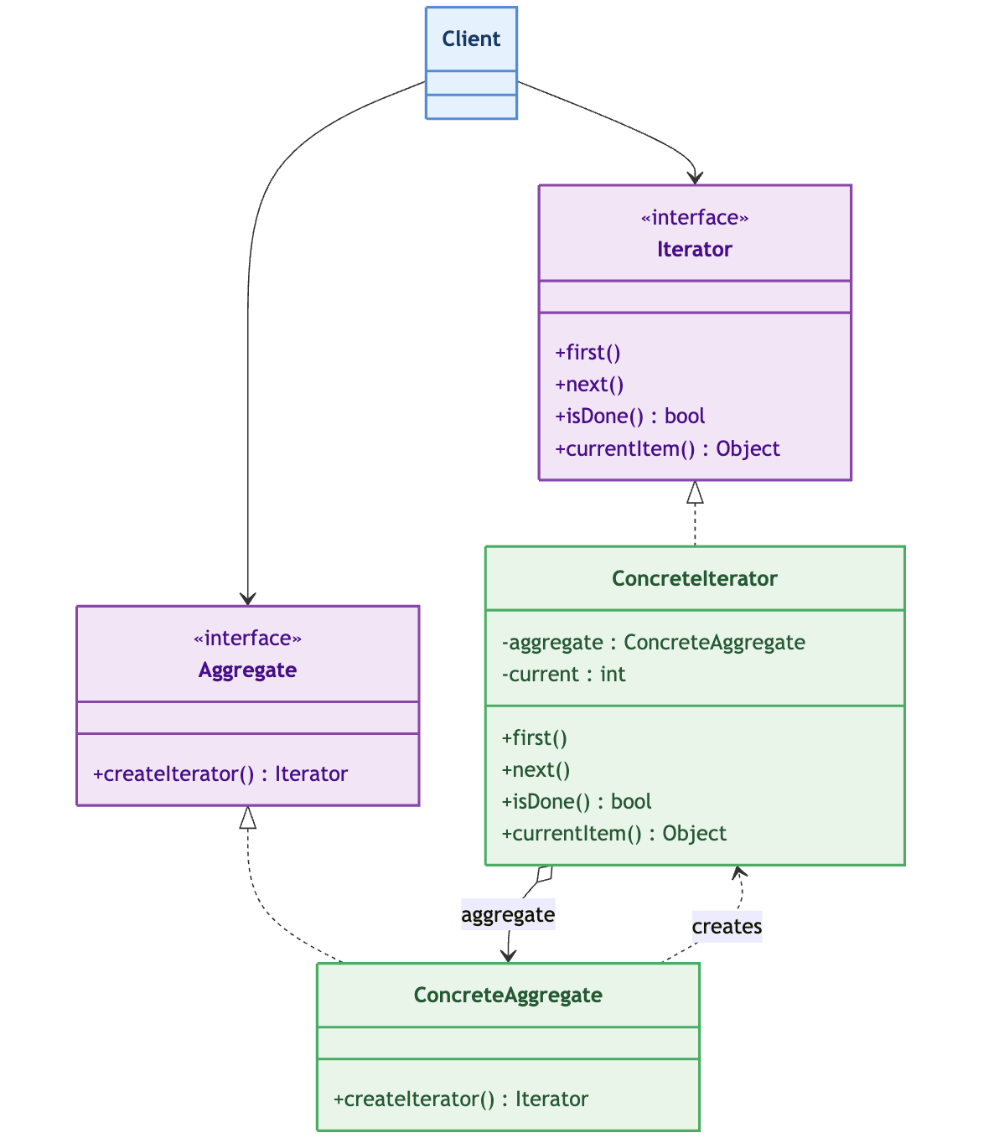
Iterator – Class Diagram

Slide 87
Iterator – Phonebook – The database
public class PhoneBook implements Aggregate {
private String[] entries;
private int size;
public PhoneBook(int capacity) {
this.entries = new String[capacity];
this.size = 0;
}
public void add(String name, String number) {
if (size >= entries.length) {
throw new RuntimeException("PhoneBook is full");
}
entries[size++] = name + ": " + number;
}
public int getSize() {
return size;
}
@Override
public Iterator createIterator() {
return new PhoneBookIterator(this);
}
// Package-private access for the iterator
String getEntry(int index) {
if (index < 0 || index >= size) {
throw new IndexOutOfBoundsException("Index: " + index);
}
return entries[index];
}
int getSizeInternal() {
return size;
}
void removeAt(int index) {
for (int i = index; i < size - 1; i++) {
entries[i] = entries[i + 1];
}
size--;
}
}
public interface Aggregate {
public Iterator createIterator();
}

Slide 88
Iterator – Phonebook – The iterator
public class PhoneBookIterator implements Iterator {
private PhoneBook phoneBook;
private int current;
private Object lastReturned;
public PhoneBookIterator(PhoneBook phoneBook) {
this.phoneBook = phoneBook;
this.current = 0;
this.lastReturned = null;
}
@Override
public boolean hasNext() {
return current < phoneBook.getSizeInternal();
}
@Override
public Object next() {
if (!hasNext()) {
throw new java.util.NoSuchElementException("No more elements");
}
lastReturned = phoneBook.getEntry(current);
current++;
return lastReturned;
}
@Override
public void remove() {
if (lastReturned == null) {
throw new IllegalStateException("next() must be called before remove()");
}
phoneBook.removeAt(current - 1);
current--;
lastReturned = null;
}
}
public interface Iterator {
/**
* Checks if there are more elements to traverse.
* @return true if the iteration has more elements
*/
boolean hasNext();
/**
* Returns the next element in the traversal.
* @return the next element as Object
*/
Object next();
/**
* Removes from the aggregate the last
* element returned by next().
*/
void remove();
}

Slide 89
Iterator – Phonebook – Application
public class Main {
public static void main(String[] args) {
// Create the aggregate
PhoneBook phoneBook = new PhoneBook(10);
phoneBook.add("Alice", "555-0101");
phoneBook.add("Bob", "555-0102");
phoneBook.add("Charlie", "555-0103");
phoneBook.add("Diana", "555-0104");
// Create an iterator via the aggregate (client doesn't know internals)
Iterator it = phoneBook.createIterator();
// Traverse using only the Iterator interface
System.out.println("=== Phone Book Entries ===");
while (it.hasNext()) {
Object entry = it.next();
System.out.println(entry);
}
// Demonstrate remove()
System.out.println("\\n=== Removing 'Bob' during iteration ===");
Iterator it2 = phoneBook.createIterator();
while (it2.hasNext()) {
Object entry = it2.next();
if (entry.toString().startsWith("Bob")) {
it2.remove();
System.out.println("Removed: " + entry);
} else {
System.out.println("Kept: " + entry);
}
}
// Verify final state
System.out.println("\\n=== Final Phone Book ===");
Iterator it3 = phoneBook.createIterator();
while (it3.hasNext()) {
System.out.println(it3.next());
}
}
}

Slide 90
Iterator – Tree traversal

Slide 91
Iterator – Pros and cons
Advantages
Simplified aggregate interface: no traversal methods pollute the aggregate, it only stores and creates iterators
Multiple simultaneous traversals: each iterator has independent state, two clients can iterate the same list at different positions
Independent extensibility: new traversals are new classes, no modification to existing code
Encapsulation: the cursor is hidden inside the iterator, the client cannot corrupt it
Polymorphic client code: one while(it.hasNext()) loop works for any aggregate type
Disadvantages
Class proliferation: each aggregate type needs its own iterator class (or a family of them)
Complexity for non-linear structures: tree/graph iterators require stacks, queues, or recursion internally
Memory overhead: one object per active traversal (not a big deal, but present anyway)

